Slide 1
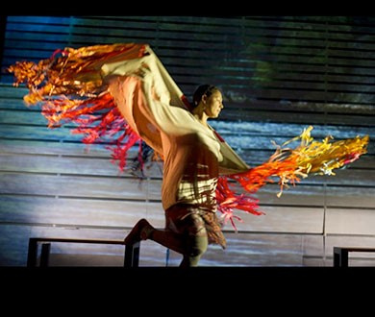
NEW Board member orientation 2021
CDF grantee Theatre for Living

Slide 2
ORIENTATION FOR NEW BOARD DIRECTORS & COMMITTEE MEMBERS
1. Mission & Vision
2. Values
3. List of Board Committees
4. Staff Structure – Your Go-To’s
5. Granting Framework
History – The Impact of our Funds
Granting Cycle
Partnerships
.

Slide 3
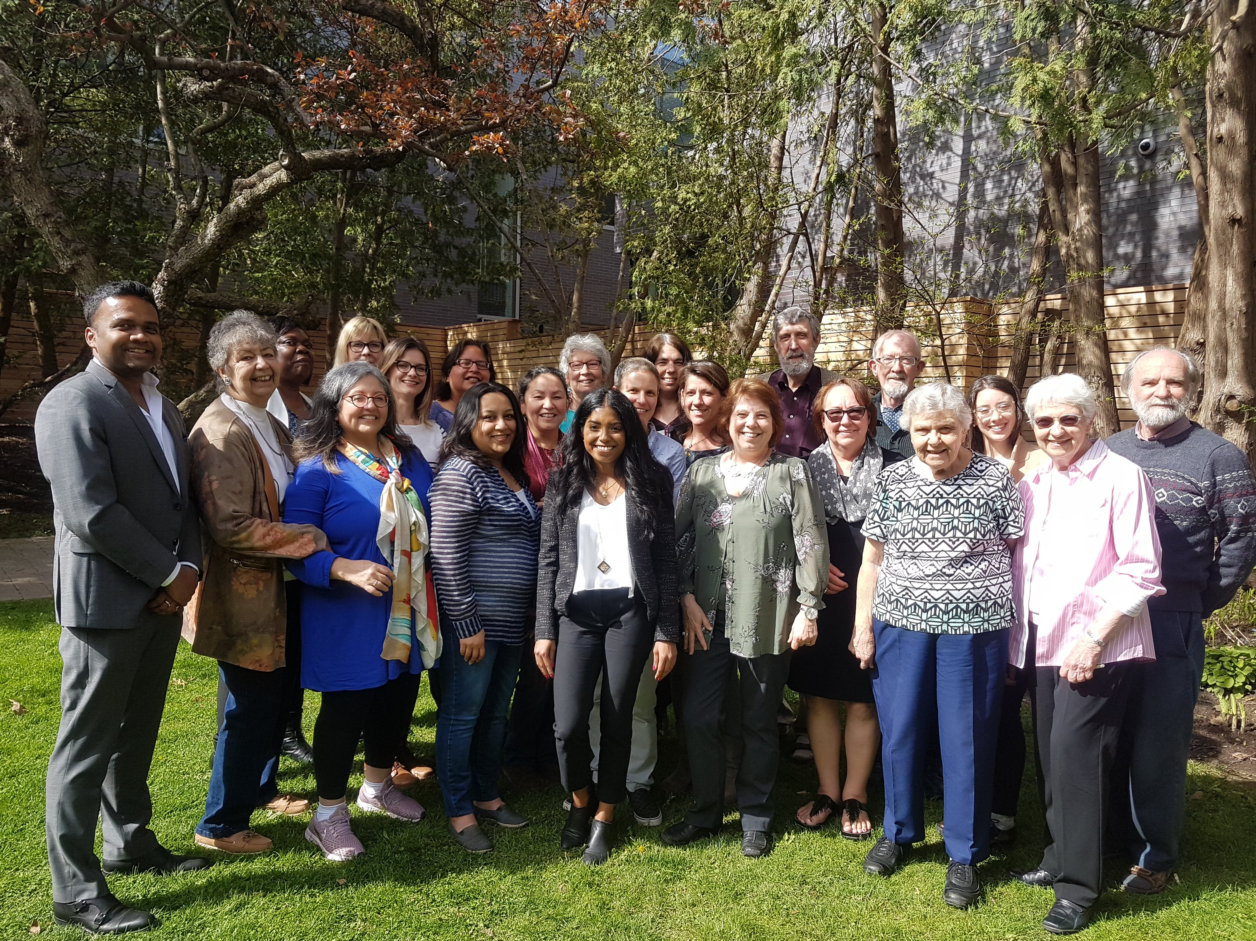

Slide 4
Our Vision
The Catherine Donnelly Foundation's vision is to collaborate with others to create a world that respects and reverences creation; a world where all have a voice and can live with dignity to realize their full potential, a world that is open to transformation and one that seeks justice, peace and respect for all.
Our Mission
Committed to Gospel values, the Foundation strives to transform the lives of those most in need by proactively supporting creative initiatives in the areas of housing, adult education and the environment.

Slide 5
OUR VALUES
Dignity of the Person
The belief that every person has inherent dignity and worth by virtue of being created by God and therefore entitled to an equitable share of the resources of God's universe.
Spirituality of Service
Our service, marked by justice and compassion, is inspired by biblical values and Christian principles and the Gospel directive that Christ came into the world not to be served but to serve (Mk 10:45).
Innovative and Creative Ideas
The Foundation believes in ideas that demonstrate proactive and creative responses to needs in the three areas of funding.
Partnership
The Foundation believes that cooperative ventures with other agencies of similar values ensure a more effective service to needs in the three funding areas.
Synergy/Integration
The Foundation will be biased towards projects and initiatives that simultaneously try to address more than one of the particular needs chosen for its support in the three areas for funding.
Ecological Integrity & Environmental Sustainability
The Foundation believes in the critical need for ecological integrity and environmental sustainability, out of which comes a profound conviction that a fundamental shift toward a holistic earth-centered value system is imperative.

Slide 6
List of Board CommitteeS
Executive Committee
Governance Committee
Finance Committee
Investment Committee
Human Resources and Compensation Committee
Grant Committees
Adult Education
Environment
Housing

Slide 7
Who ya going to Call?
Communities we Serve
CDF Board
CDF Committees
Executive Director
Claire Barcik
Director of Finance & Investment
MJ (Mritunjay) Sinha
Financial Administrator (0.6FTE)
Cindy Alexander
Director of Programs
Anne Mark
Communications & Policy Officer (0.5FTE)
Steve Brearton
Grants & Office Coordinator
Shanjitha Rajasingam

Slide 8
Granting History
Housing
Adult Education
Environment
2005-2019
50/50 split
Approaching $20 Million in total charitable giving in 2021
Nearly $12 million to more than 400 project grants
And $7 million to deeper long-term partnerships including
$750 K to Ecojustice
$1.25 mill to A Way Home
$1.25 mill to Righting Relations

Slide 9
Granting history
Grants by granting area
Adult Education $6,295,991 (31.7%)
Environment $7,051,094 (35.6%)
Housing $6,295,848 (31.7%)
Other $173,000 (.9%)
One-year grants $10,515,983
Multi-year grants $7,921, 950
Special grants $1,378,000
Total $19,815,933

Slide 10
Twice Yearly OPEN Granting CYcle
Call for Applications
Letters of Inquiry Online
Vetting Process – Staff & Grant Committees
Invitation to Submit Full Application
Grant Committee Vetting & Recommendation to Board

Slide 11
“Through this CDF-supported initiative, we can ensure that no one who comes through our doors, fleeing persecution and seeking protection in Canada, is forced into homelessness or separated from family members.”
Halifax Refugee Clinic Executive Director Julie Chamagne

Slide 12
Housing committee Mandate
The Catherine Donnelly Foundation wishes to advance systems-change and lasting solutions in Canada's housing sector. It sets out to partner with organizations that are working to prevent and end homelessness, by addressing a lack of affordable housing through innovative and collaborative strategies and solutions. The CDF will consider projects that generate evidence, build capacity, advance collective solutions, and encourage public policy change that will build a vibrant non-profit and social housing sector.
E.g. A Way Home
A Way Home Canada

Slide 13
"The Catherine Donnelly Foundation is more than just a funder. CDF is a strategic partner, working alongside us to create systems change. We wouldn't be where we are today without their support."
Melanie Redman, President & CEO, A Way Home

Slide 14
Environment Committee
The Catherine Donnelly Foundation's Environment Program seeks to mobilize public opinion to build up 'just' industries and economies of the future that generate green jobs as part of a low-carbon economy, that support place-based, resilient, wellbeing economies that protect workers’ rights, eradicate poverty, distribute wealth equitably, and uphold human rights.
E.g. Ecojustice; Low Carbon Funders Group; Healing Through the Land
Iron & Earth Solar Skills

Slide 15
Without the support of the Catherine Donnelly Foundation, we would never have gotten this project off the ground. Your initial investment kicked it off.
Katie McKinnon, Co-Executive Director, The Leap
“Early In” Bold Funder

Slide 16
Adult Education Committee
The Catherine Donnelly Foundation takes a proactive approach to adult education, viewing it as an important tool to address the most pressing social, environmental, cultural and community development problems and concerns today. We are committed to supporting projects that promote active citizenship, democracy, personal and social transformation by fostering the development of critical consciousness and skills required to promote a more just, equitable and sustainable society in Canada.
E.g. Righting Relations
Roots to Harvest
Righting Relations

Slide 17
"CDF has been the most collaborative and supportive funder I have ever worked with. They truly have walked this journey with us. And in doing so they have self-reflected and worked hard to decolonialize their practices through-out the entire organization. As one Indigenous woman stated, “CDF has supported us being us. We have not had to fit into a box but can do what we need to do to bring about healing and positive changes. That is huge.”
Ishbel Munro, National Steering Committee Righting Relations

Slide 18
Communication & Policy
Why a communication plan? • Align priorities and messaging to promote CDF’s mission. • Encourage internal education and discussion. • Tailor communication toward specific audiences. • Create targeted materials using most effective mediums to communicate with those groups. • Establish an evaluation process to assess what works and what doesn’t

Slide 19
Communication & Policy
Our communication goals Goals aligned to advance CDF’s mission to transform the lives of those most in need • Amplify the voices of our program and project partners • Differentiate CDF as a systems-change organization that works for community-led and community-driven program and project partners • Increase public and peer knowledge and dialogue of progressive, sustainable ideas in our core funding areas • Support the CDF Board with materials that advance their knowledge and understanding of program and project work as well as current issues relating to our core funding areas

Slide 20
Questions & Comments

